Slide 1
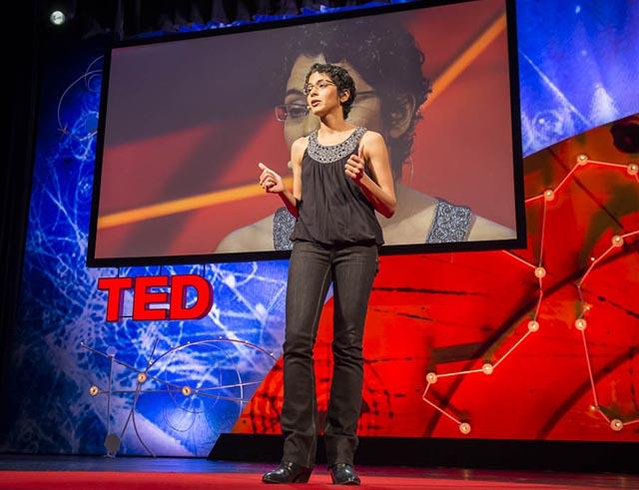
TED TALKS
Over 18 years

Slide 2
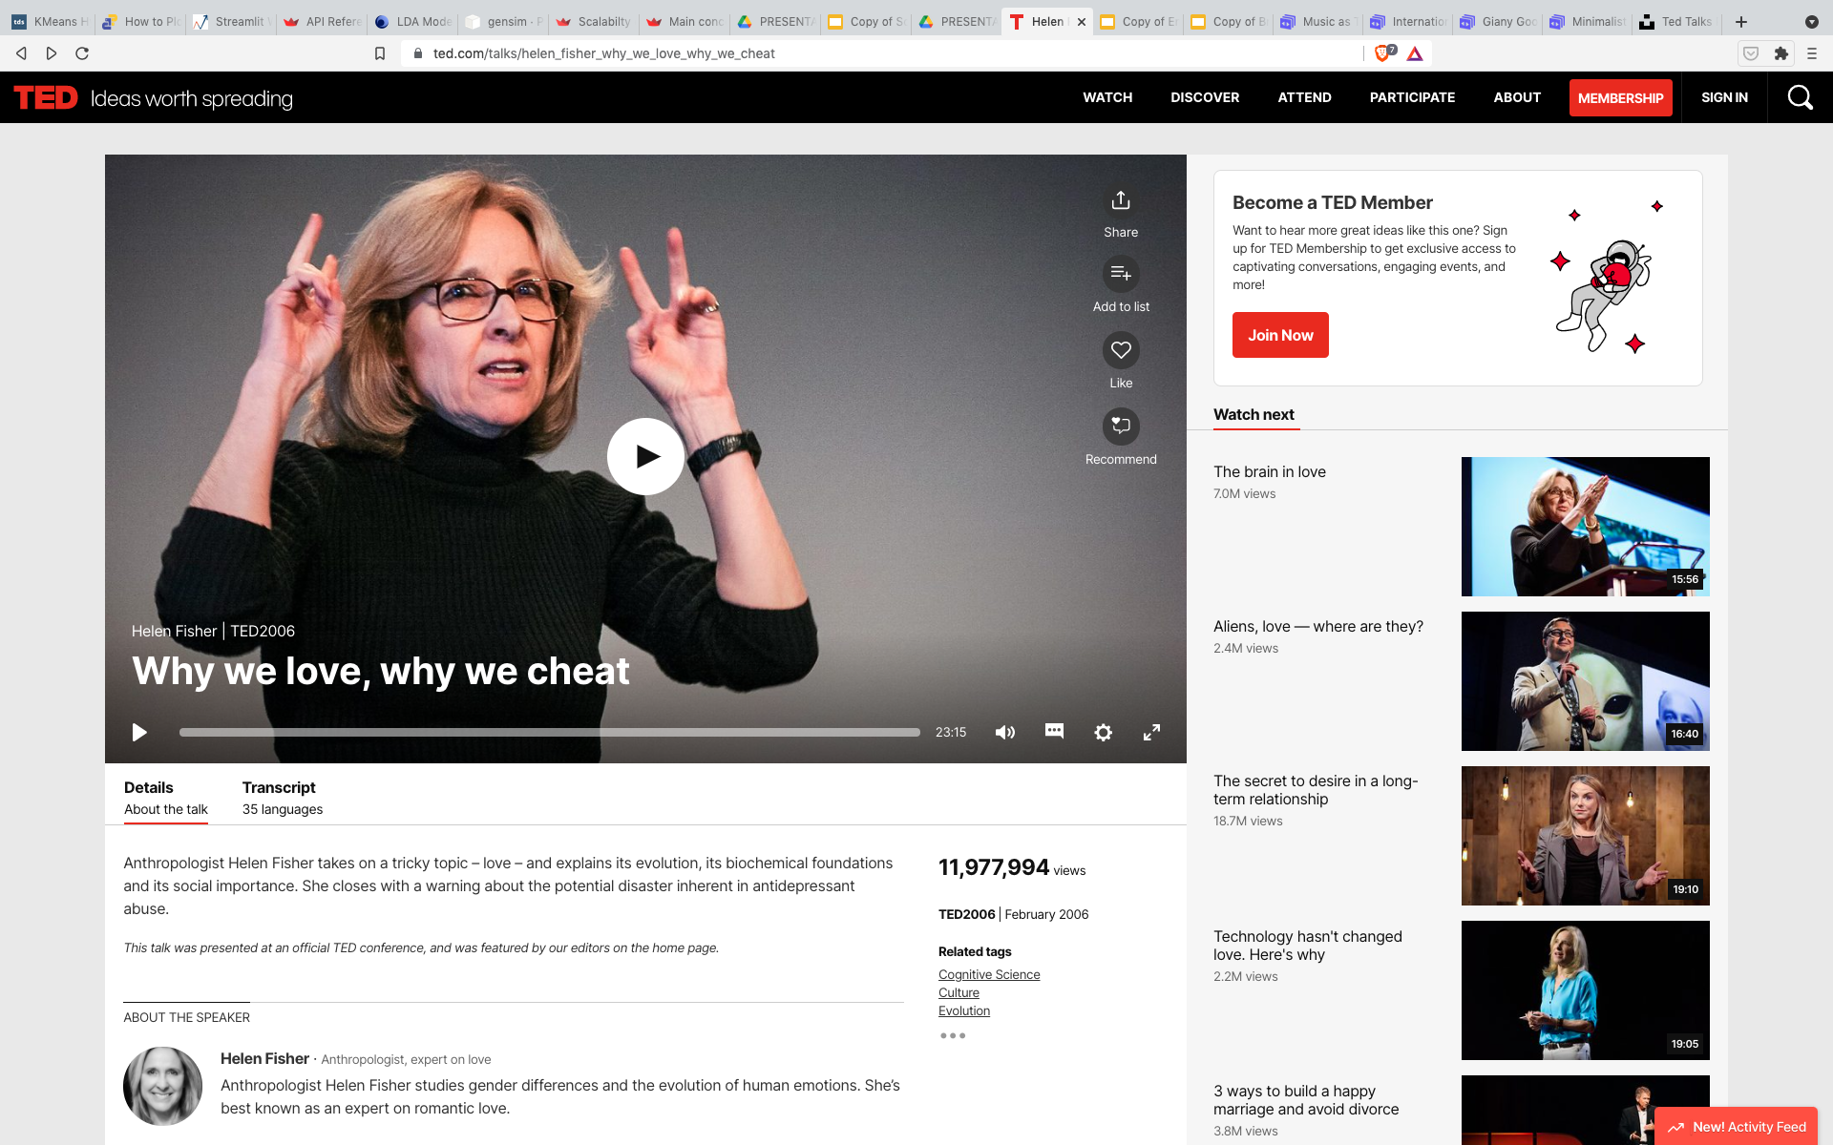

Slide 3
Fef: bu sayfada uc yeri kareye almak istiyorum, bunlar hakkinda konusacagim. Bir yapabilir misin? Kirmizi guzel gider :)
Bir onceki slide kalsin :)

Slide 4

DATA &
METHODOLOGY
01

Slide 5
DATA
4005 talks scraped (mid 2020)
w/ 18 features
(for NLP) Transcripts
(as Metadata) Views, Comments, Date(Year) added

Slide 6
QUESTION
Over years
Change in topics
Change in engagement with specific topics

Slide 7
TOPIC MODELING
02

Slide 8
TOPIC
MODELING
COUNT
VECTORIZER
2.
LDA
3.
RECOMMENDATION SYSTEM
4.
INSPECTION-VISUAL
typical doc:
3200 words
(~10K chars)
find:
15 topics
watch:
Next Talk
search:
topic trends

Slide 9
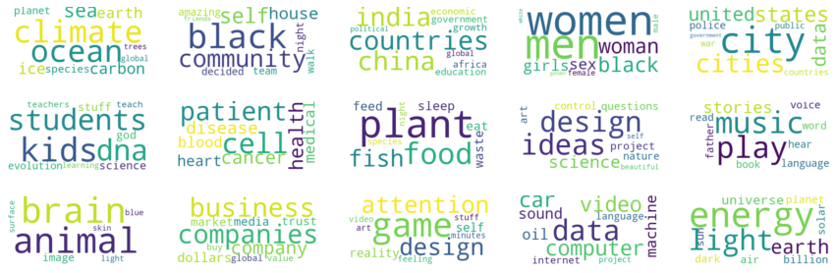
TOPICS
CLIMATE CHANGE
EDUCATION
BRAIN / ANIMAL
COMMUNITY
MEDICINE
BUSINESS / ECONOMIES
GLOBAL POLI- ECONOMIES
FOOD SYSTEMS
GAME / META
GENDER / FEMINISM(S)
DESIGN / IDEAS
TECH DEVELOPMENTS / DIGITAL
CITIES
(ORAL) CULTURE
ENERGY / EARTH

Slide 10
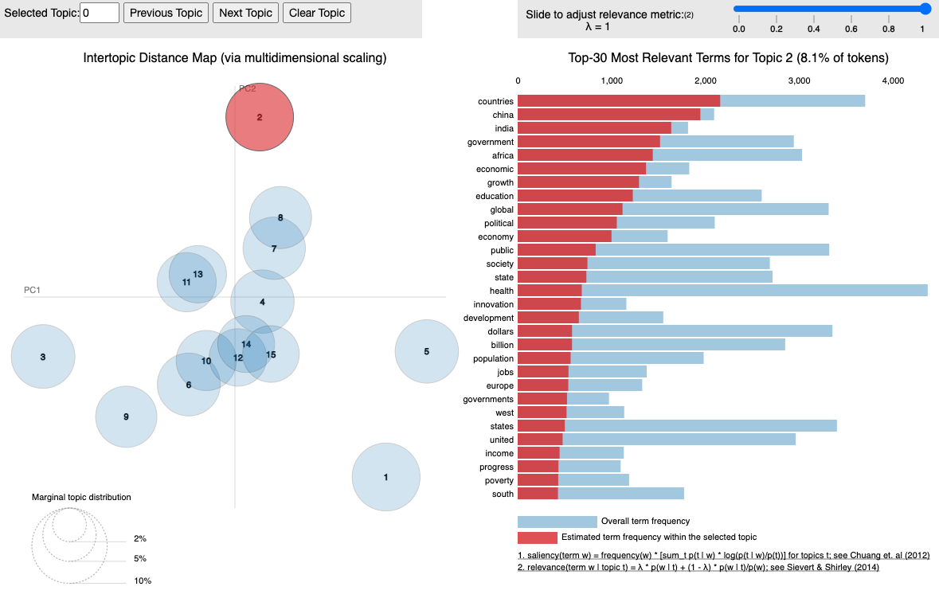
2.
GLOBAL
POLITICAL
ECONOMIES

Slide 11
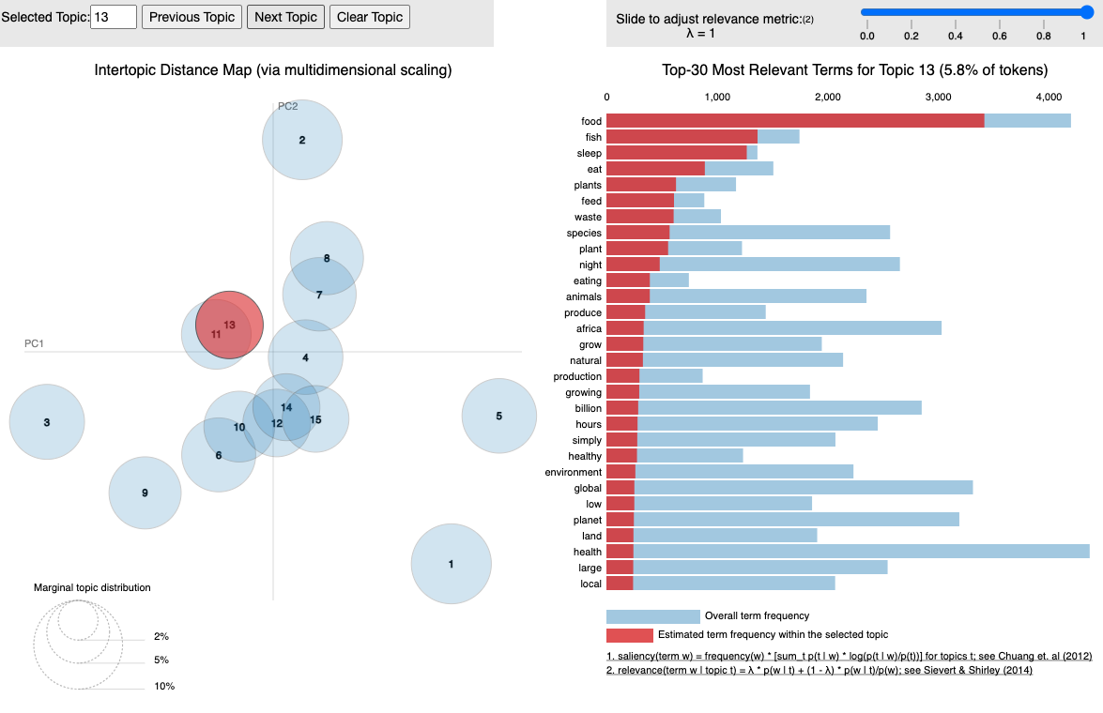
13.
FOOD
SYSTEMS

Slide 12
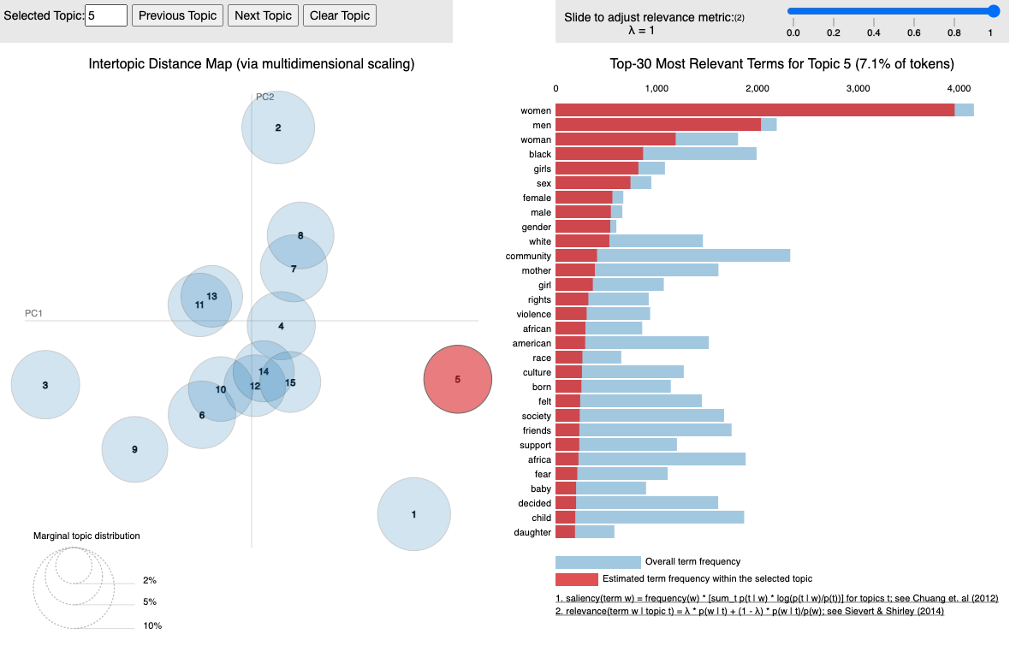
5.
GENDER /
FEMINISM(S)

Slide 13
GENDER + FEMINISM(S)
03

Slide 14
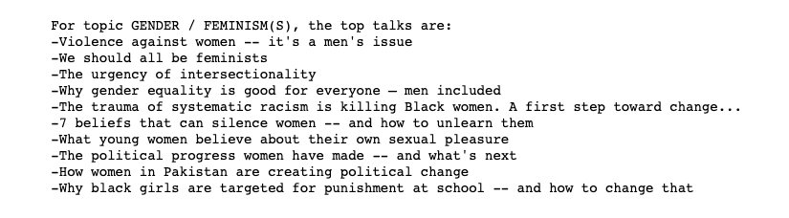
TOP
TALKS

Slide 15
3 TOP ASSOCIATIONS
(Oral) Culture
Community
Cities
Associated
Other
Topics

Slide 16
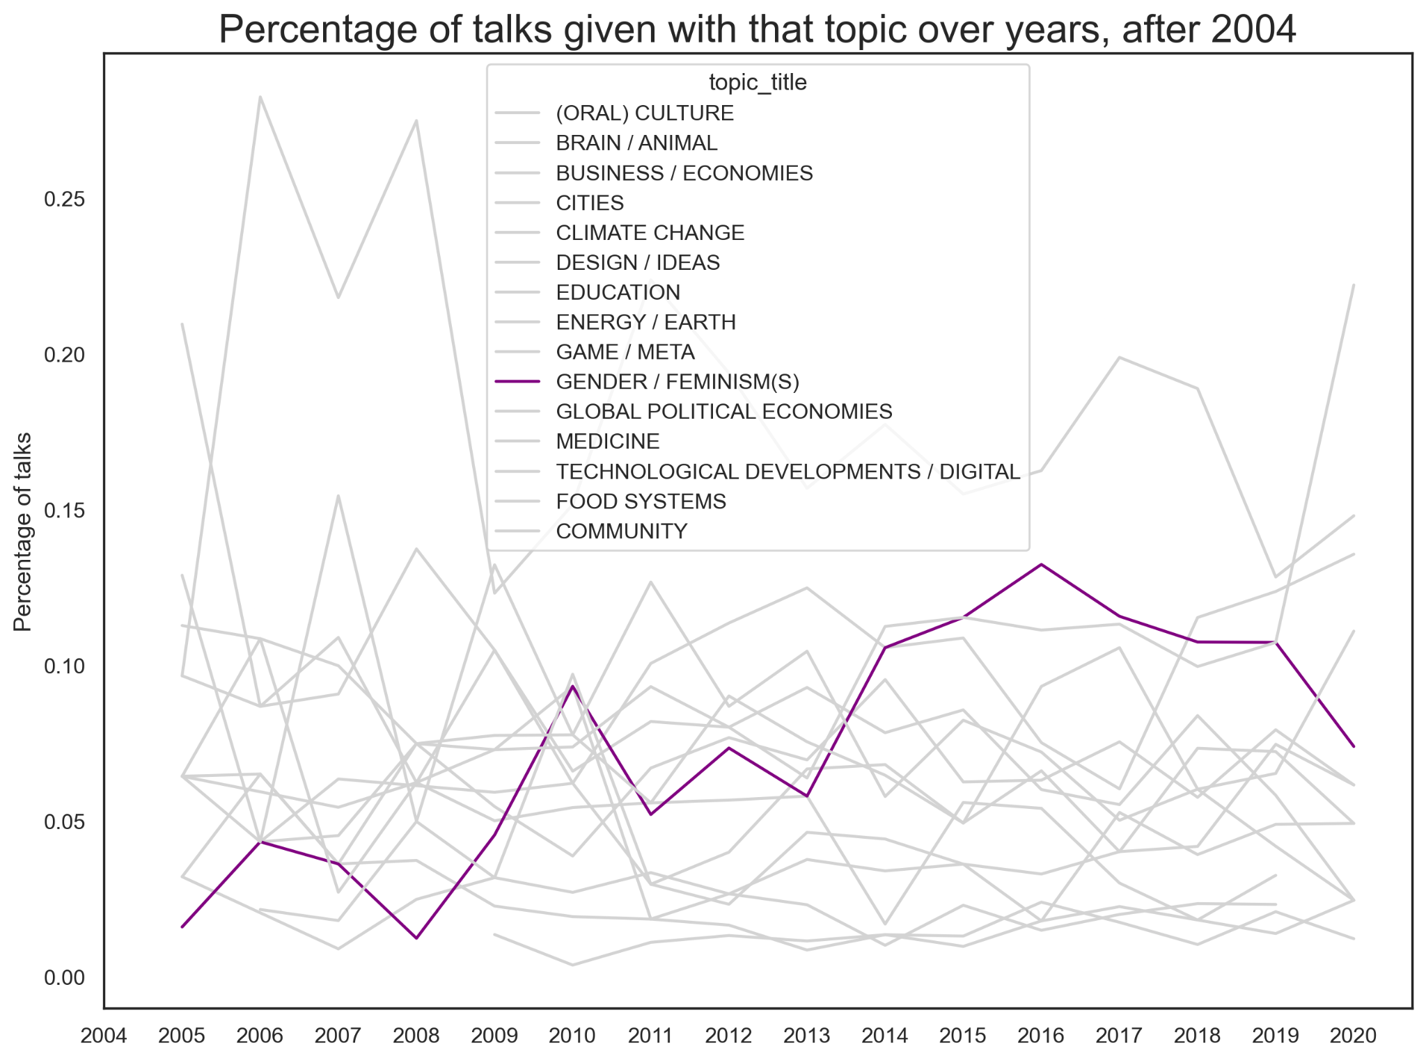
Talks
Percentage
FEMINISM(S)

Slide 17
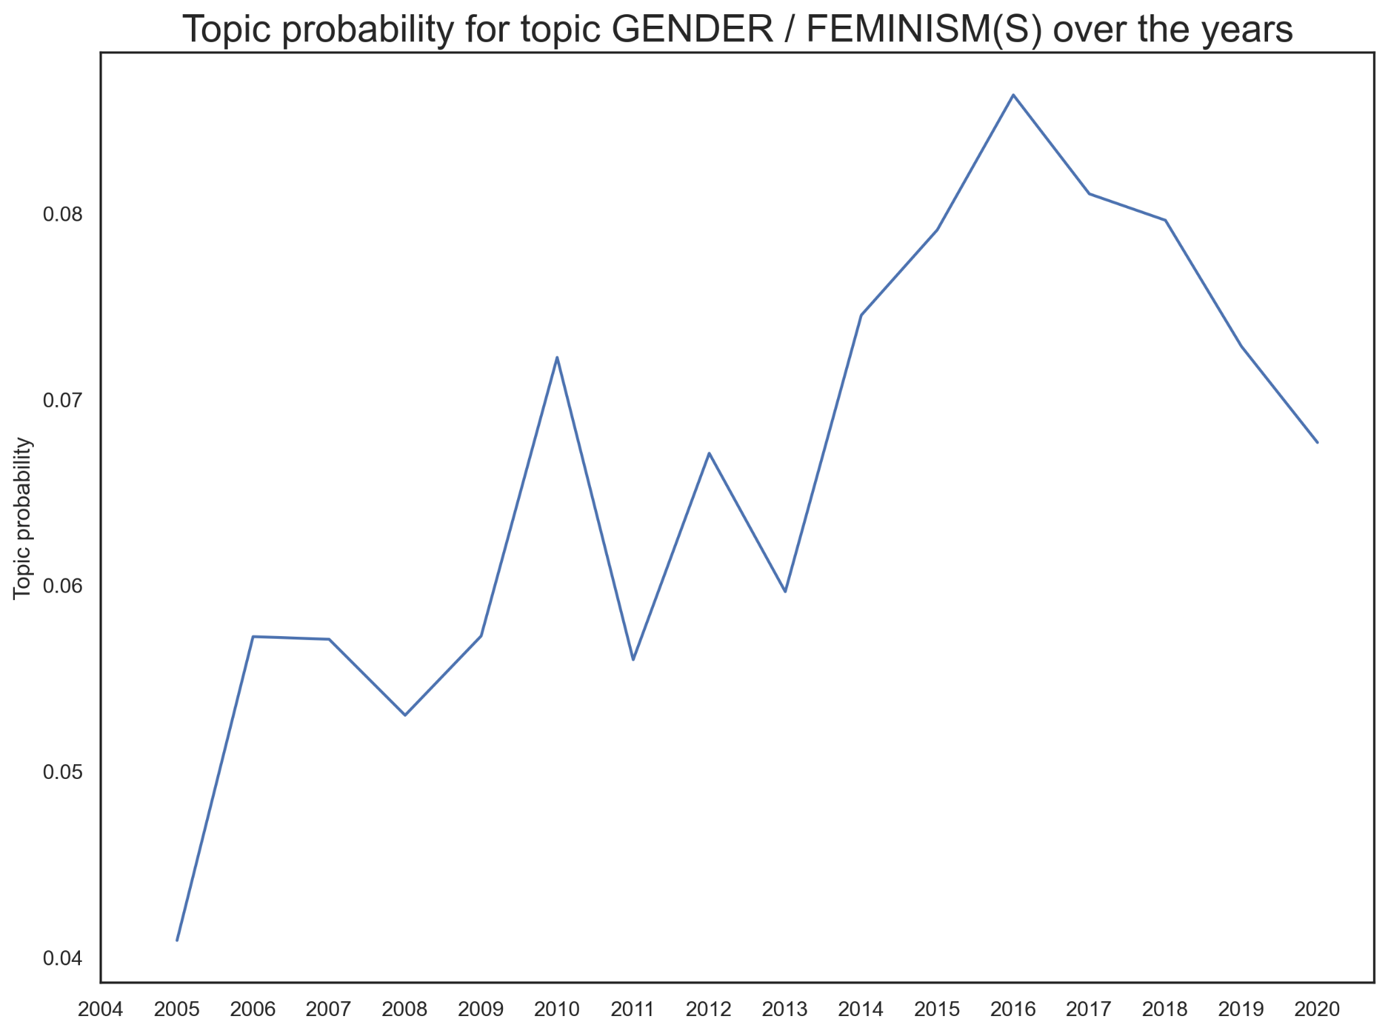
Topic
probability
FEMINISM(S)

Slide 18
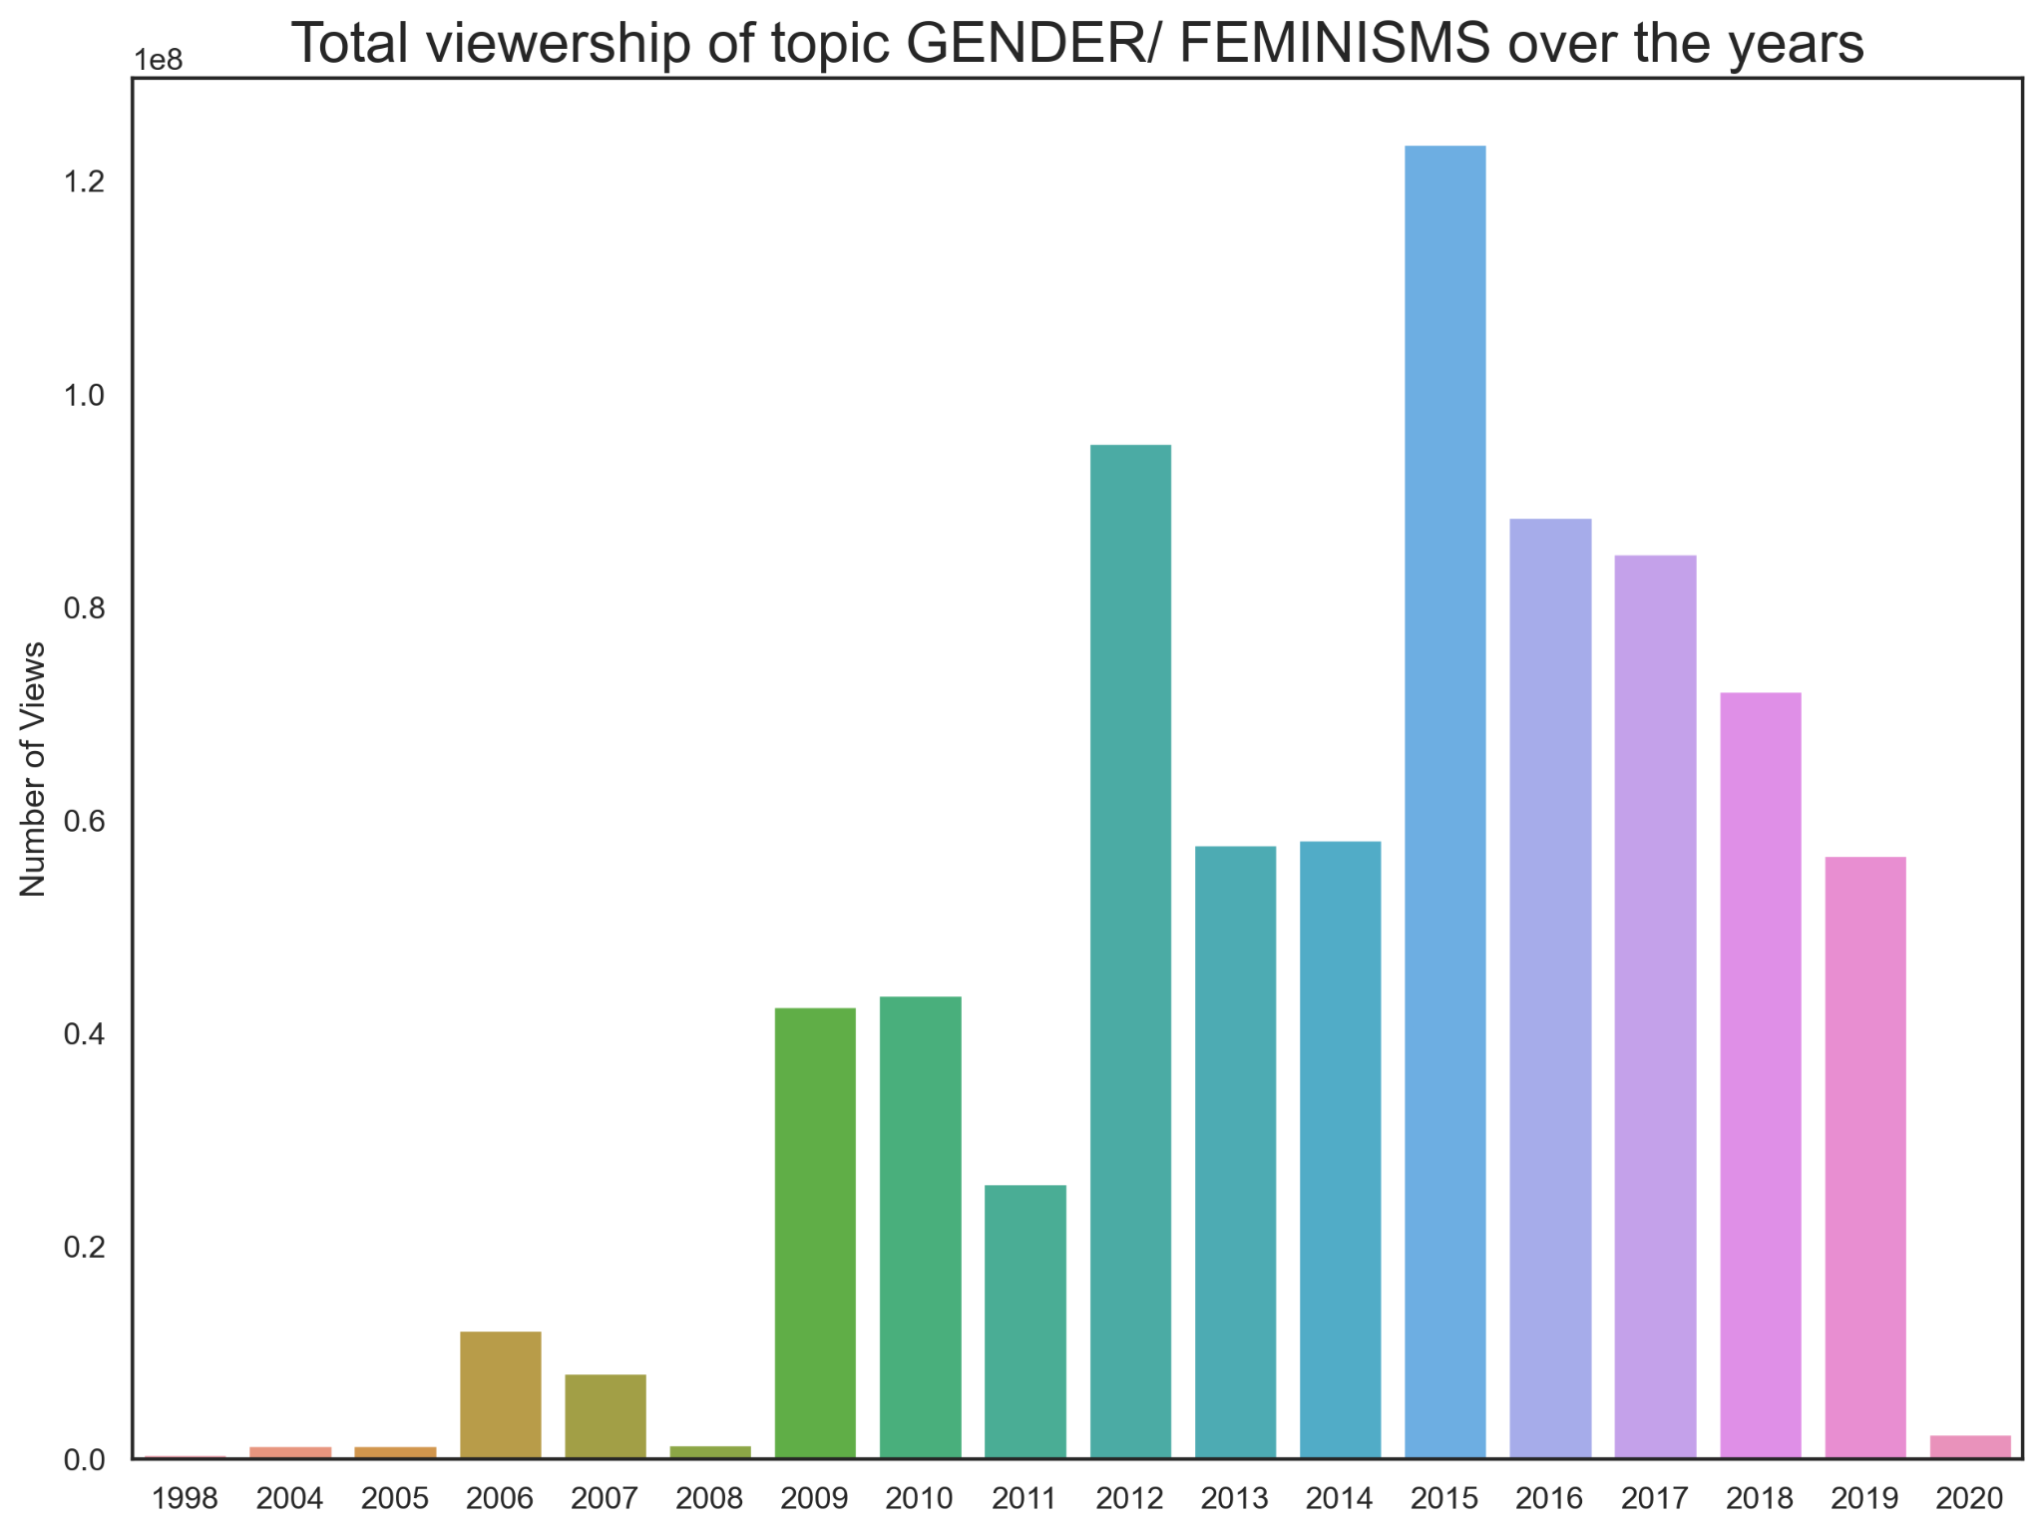
Viewership
FEMINISM(S)

Slide 19
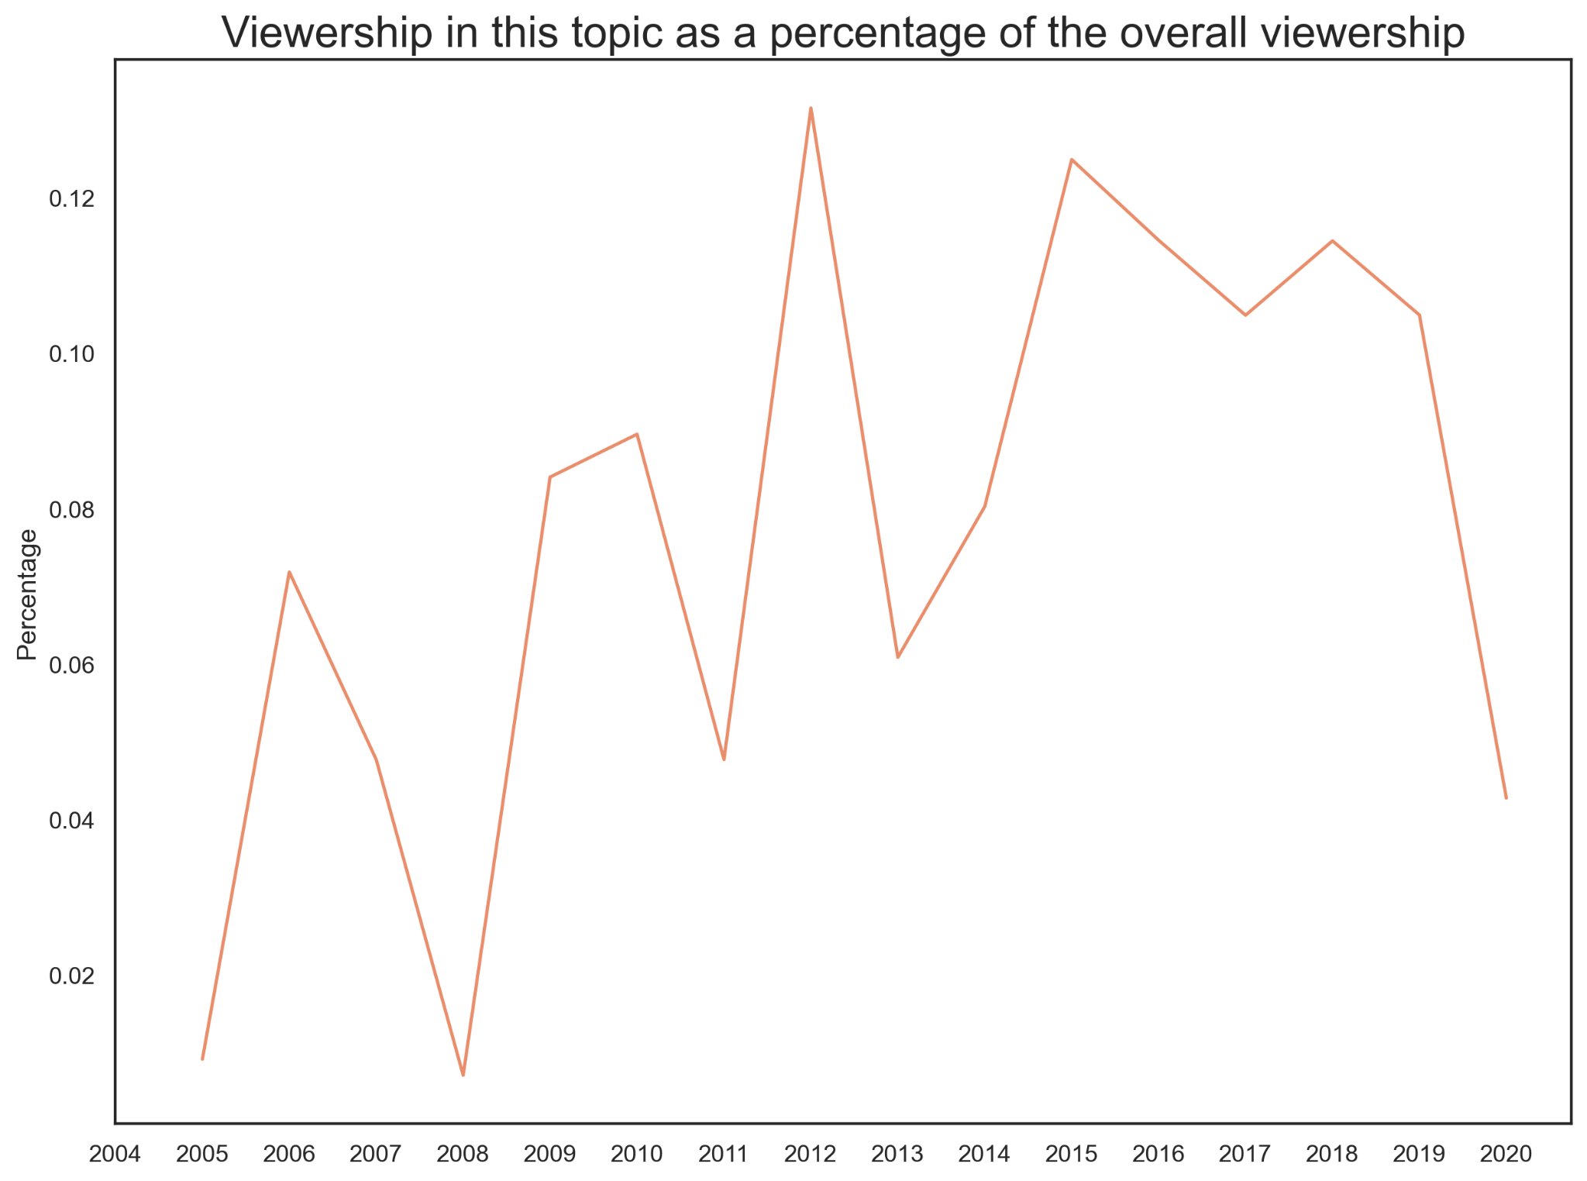
Percentage
Viewership
FEMINISM(S)

Slide 20
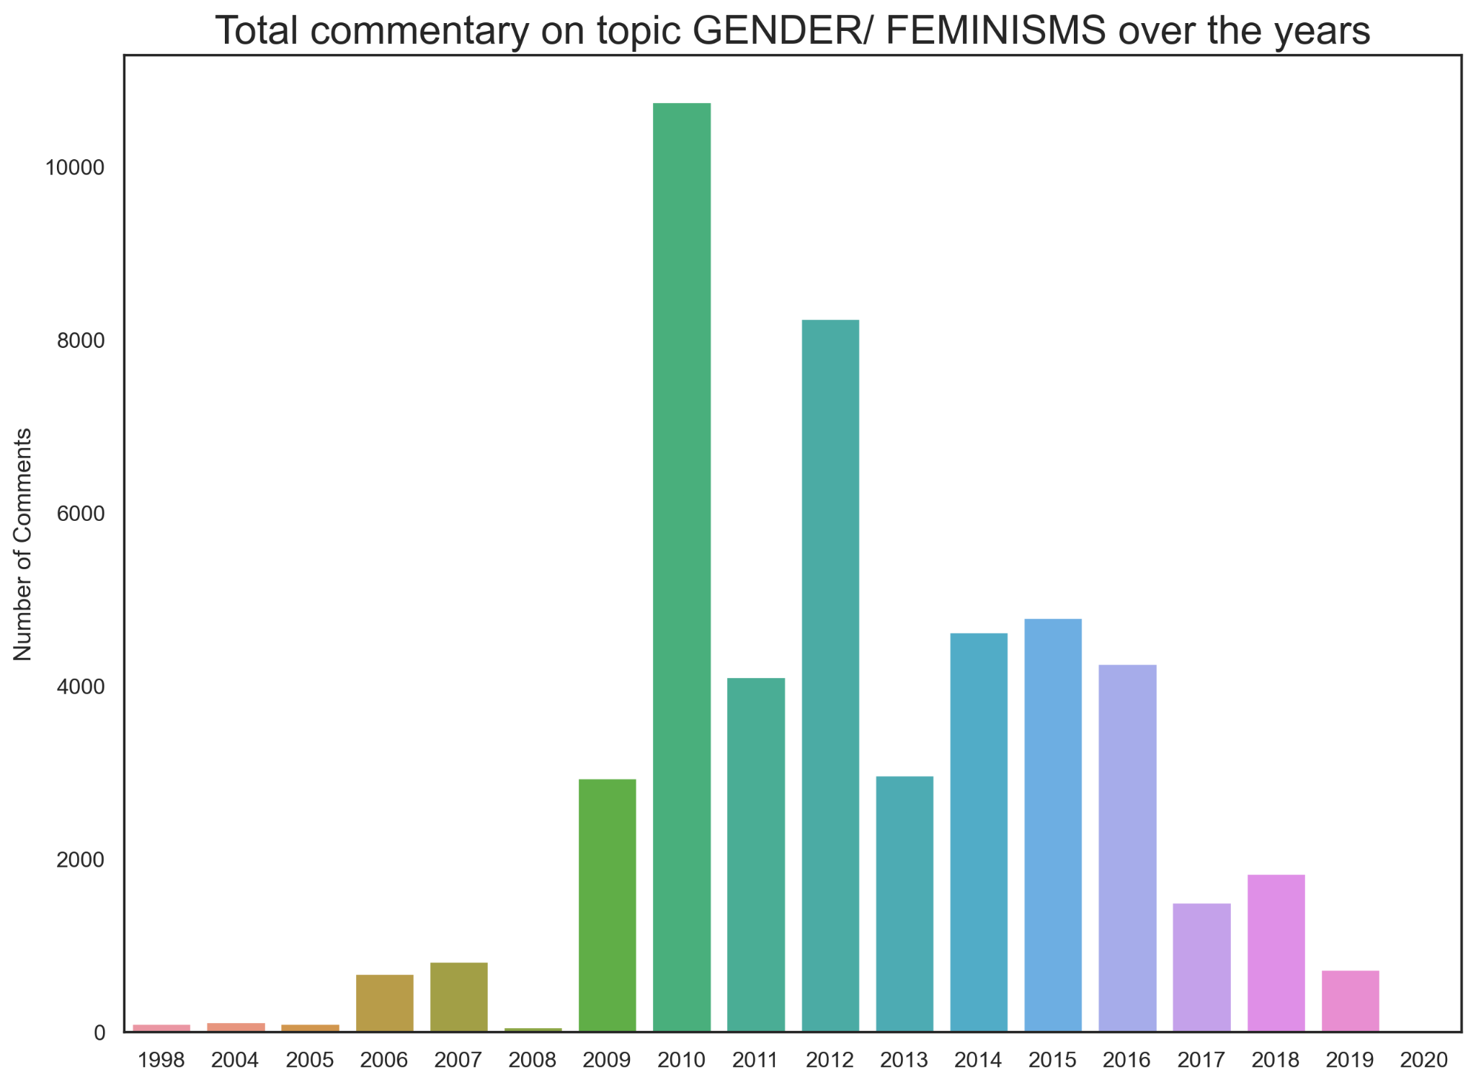
Commentary
FEMINISM(S)

Slide 21
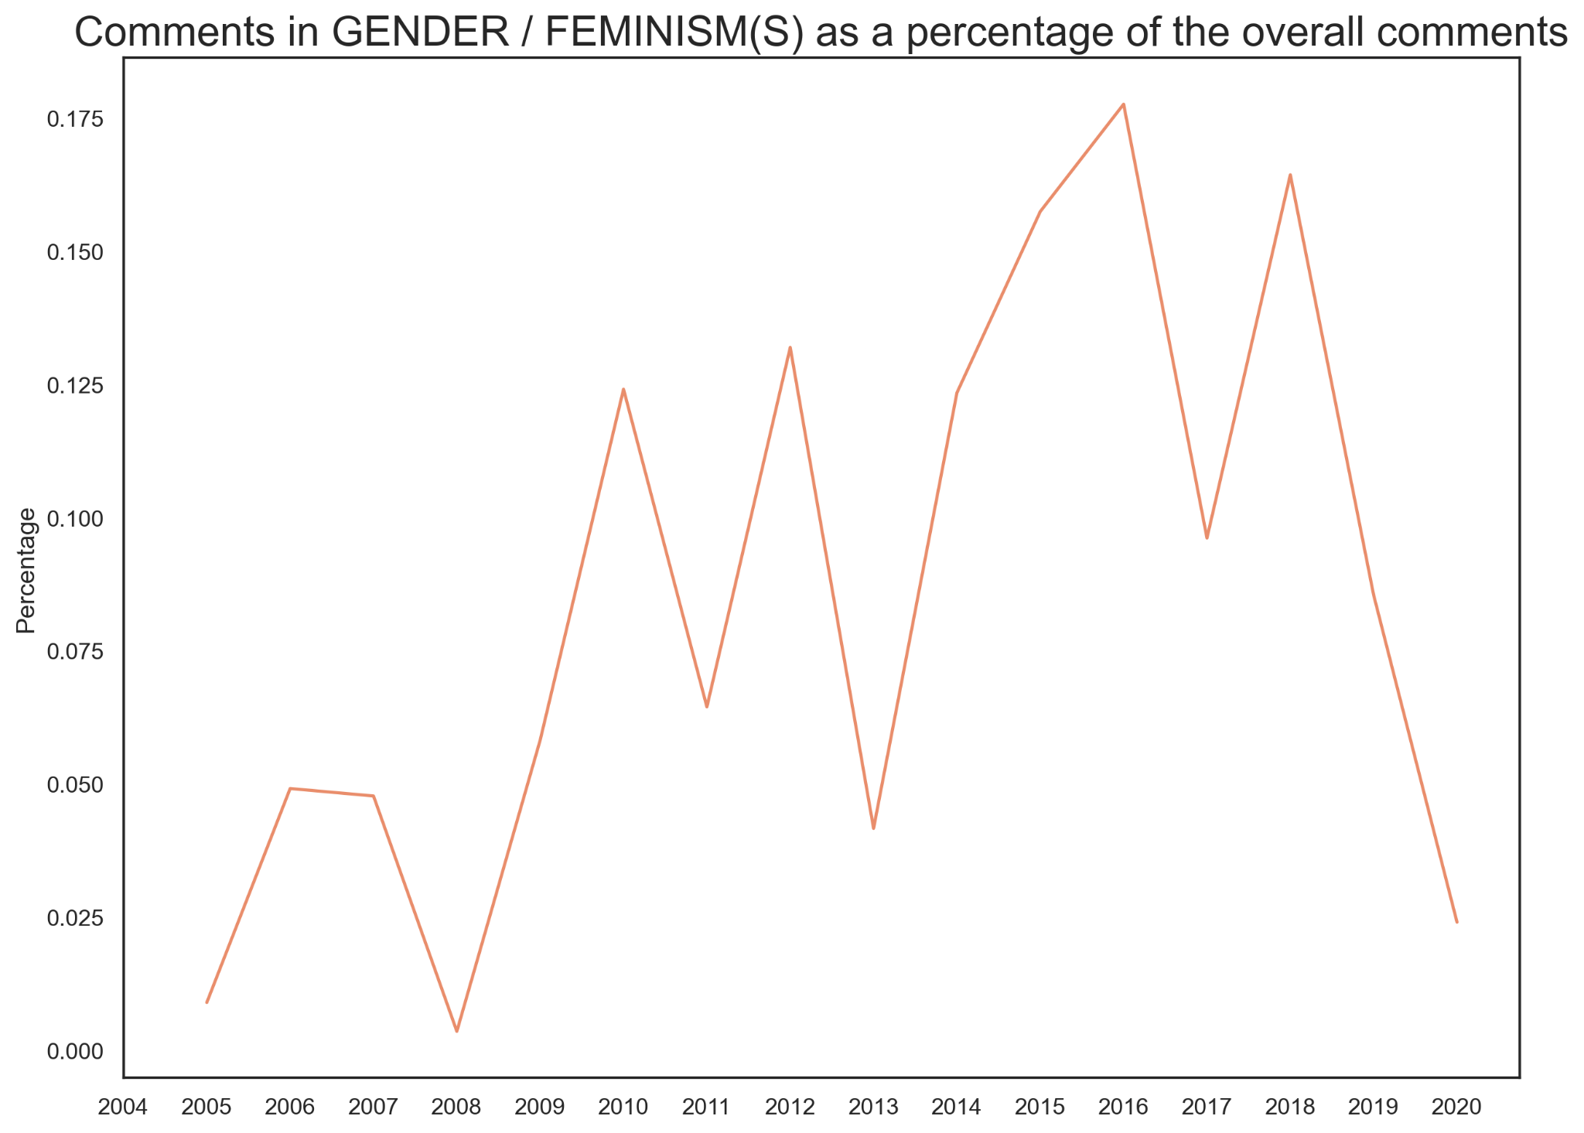
Percentage
Commentary
FEMINISM(S)

Slide 22
CONCLUSIONS
04

Slide 23
Topic Relations
On The Rise
Not so much
Talks in G/F
Viewership G/F
Comments G/F
For Gender/ Feminisms:
(Oral) Culture,
Community,
Cities
Gender / Feminisms
Medicine 🎃 surprises??
Climate Change
Education 😱
Design / Ideas
Tech Developments/ Ideas
Overall: ↑
Percentage: ↑
Probability of topic: high
Overall:
increase (around 2015)
Percentage: Same
Overall:
Until 2012 ↑, then ↓
Percentage: Same

Slide 24
FURTHER WORK
05

Slide 25
REC - SYS
REC - SYS
SUB - TOPIC MODELING
CLUSTERING
Improve the recommendation system
Compare with Watch Next!
Within the topics, are there further topics?
For tagging - incorporate into RecSys

Slide 26
QUESTIONS?
& APPENDIX
Presentation template by Slidesgo
Cover/Q Photo by James Duncan Davidson
Separator Photo by Aatik Tasneem on Unsplash

Slide 27
DATA

Slide 28
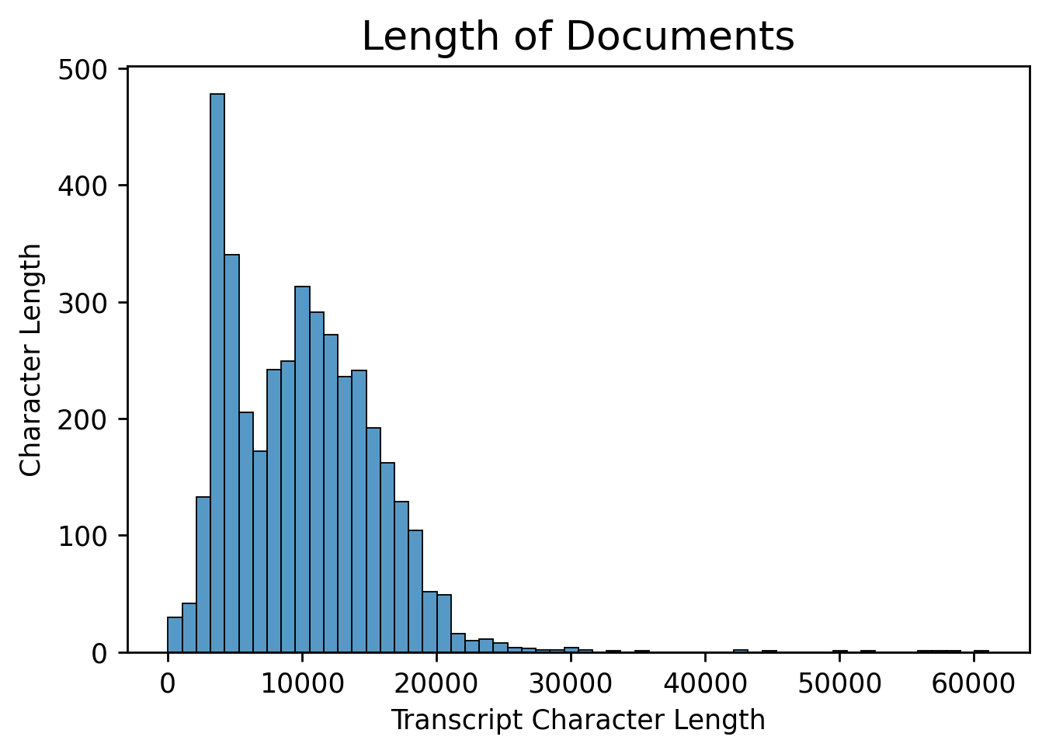
Length of
Documents

Slide 29
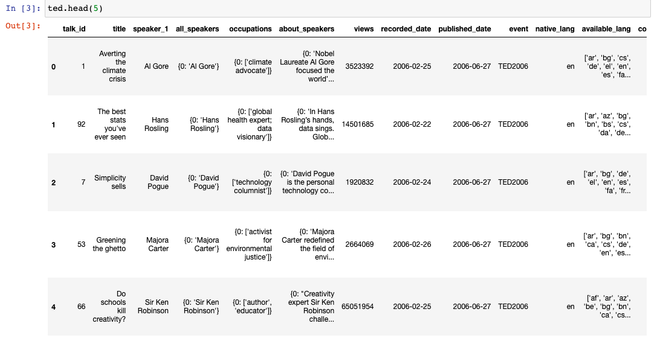
Original
Dataframe

Slide 30
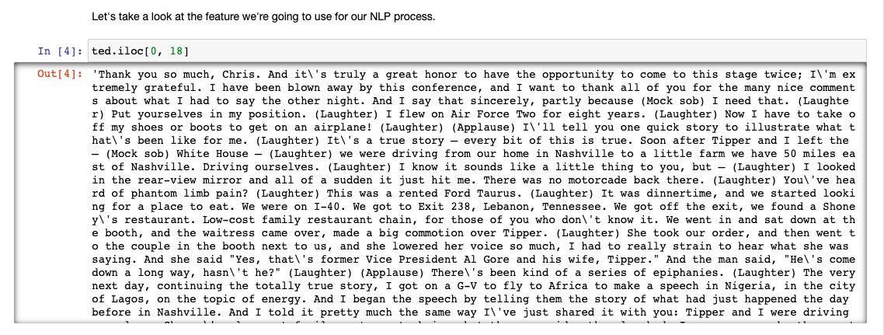
Sample
Document

Slide 31
TOPIC MODELING

Slide 32
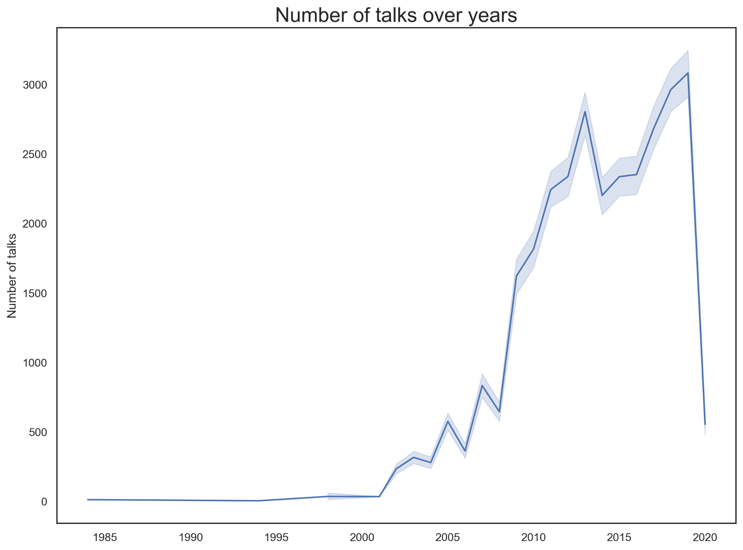
Number of
Talks
over years

Slide 33
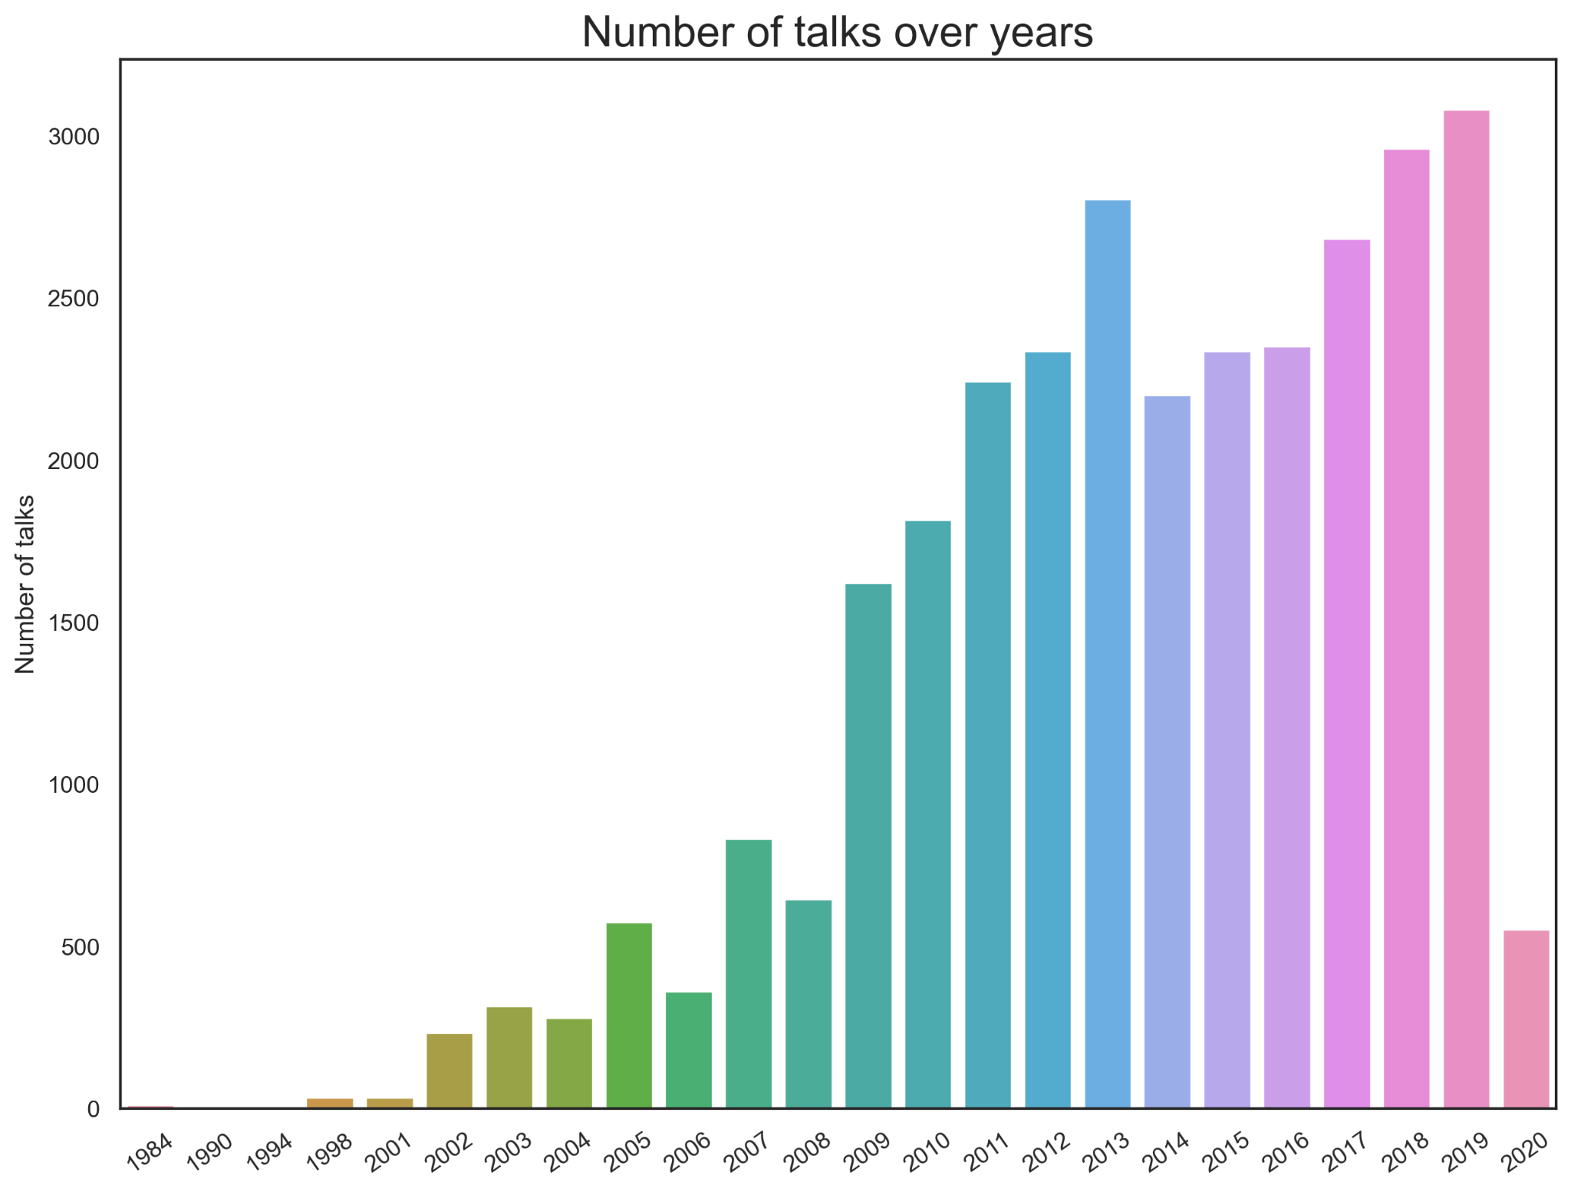
Number of
Talks
over years

Slide 34
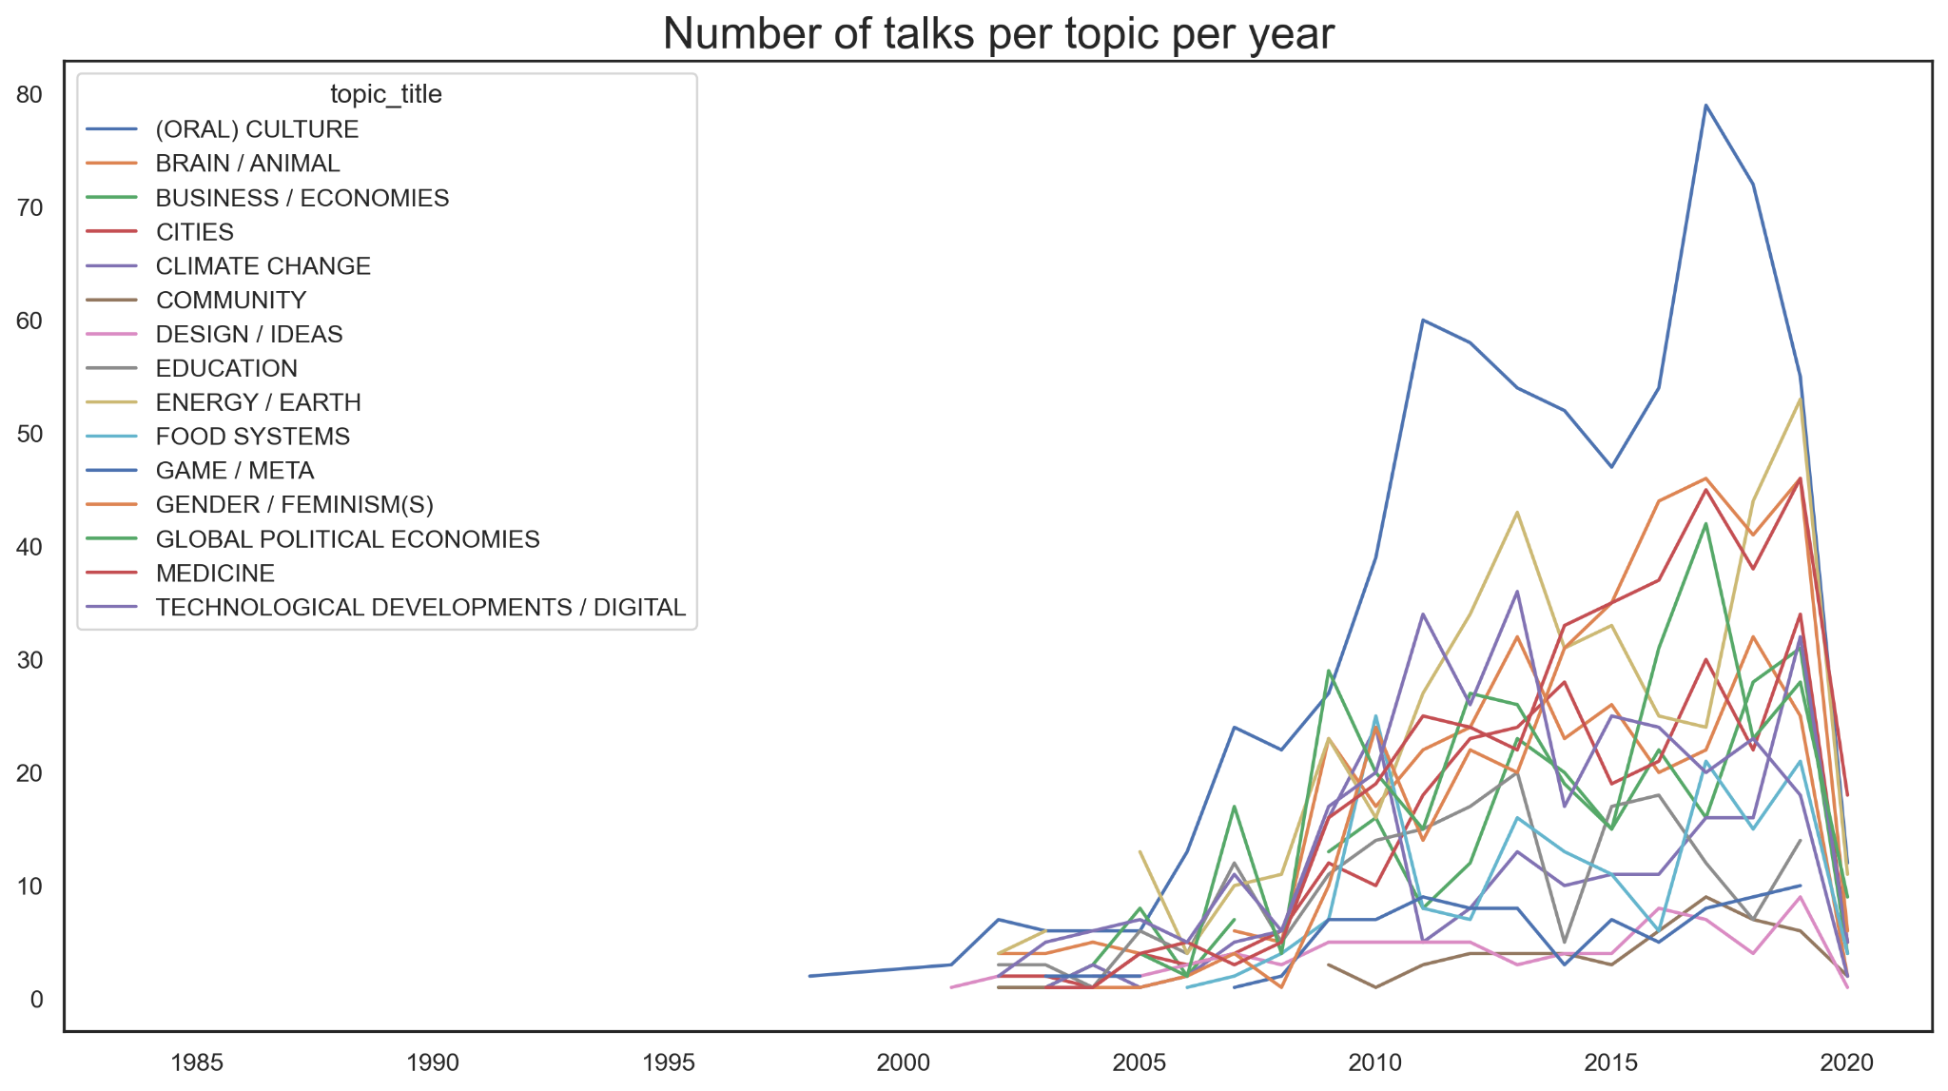
Number of
Talks
per topic
per year

Slide 35
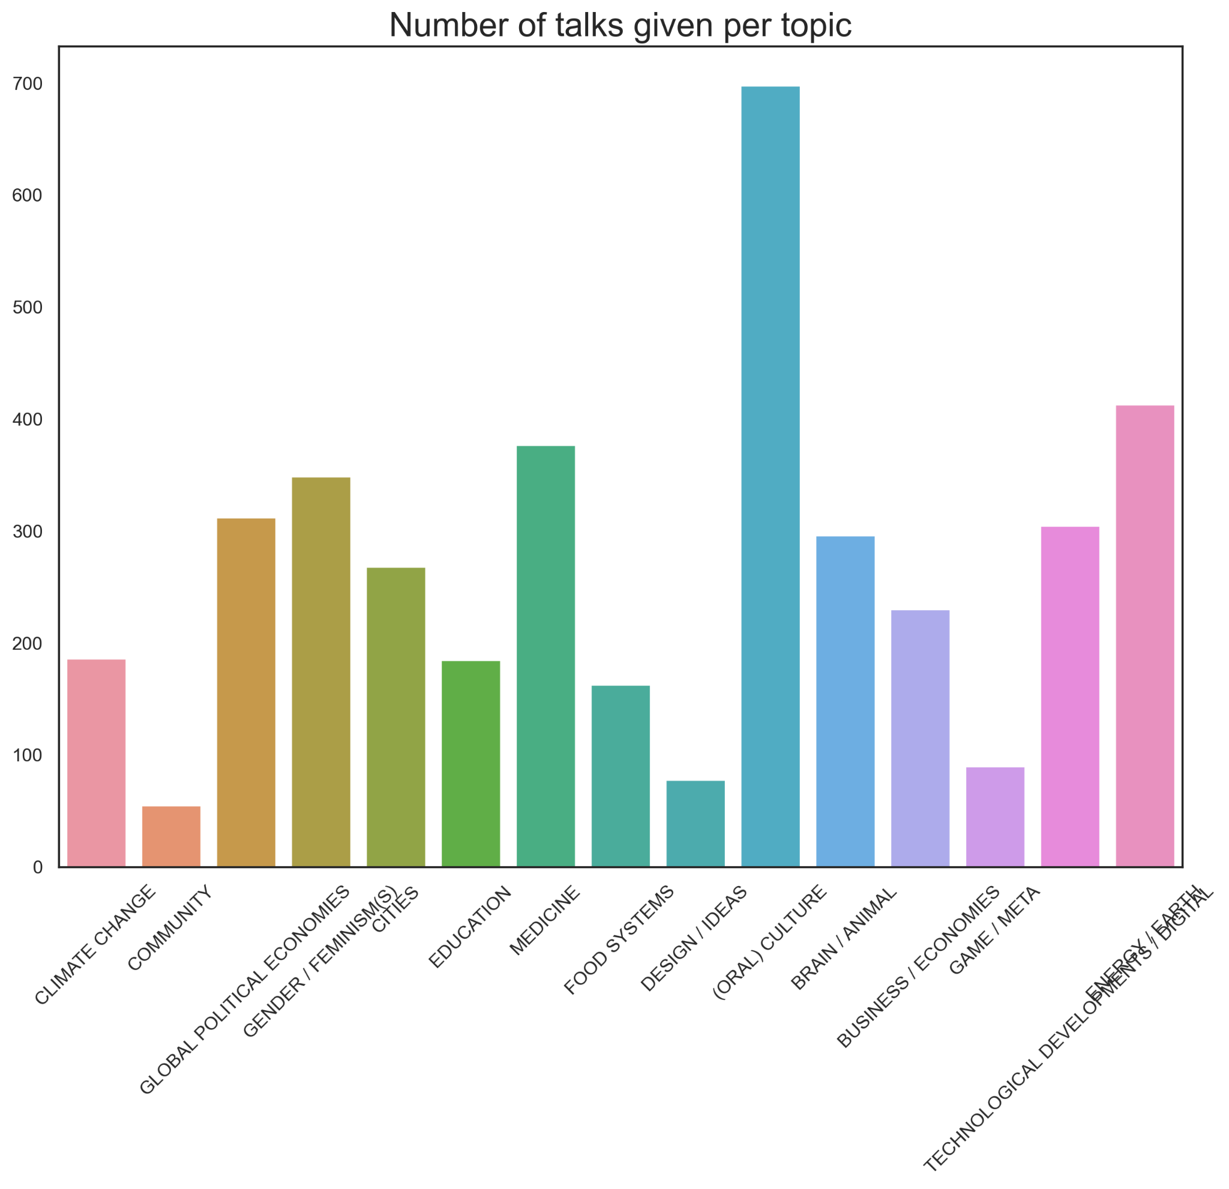
Number of
Talks
per topic

Slide 36
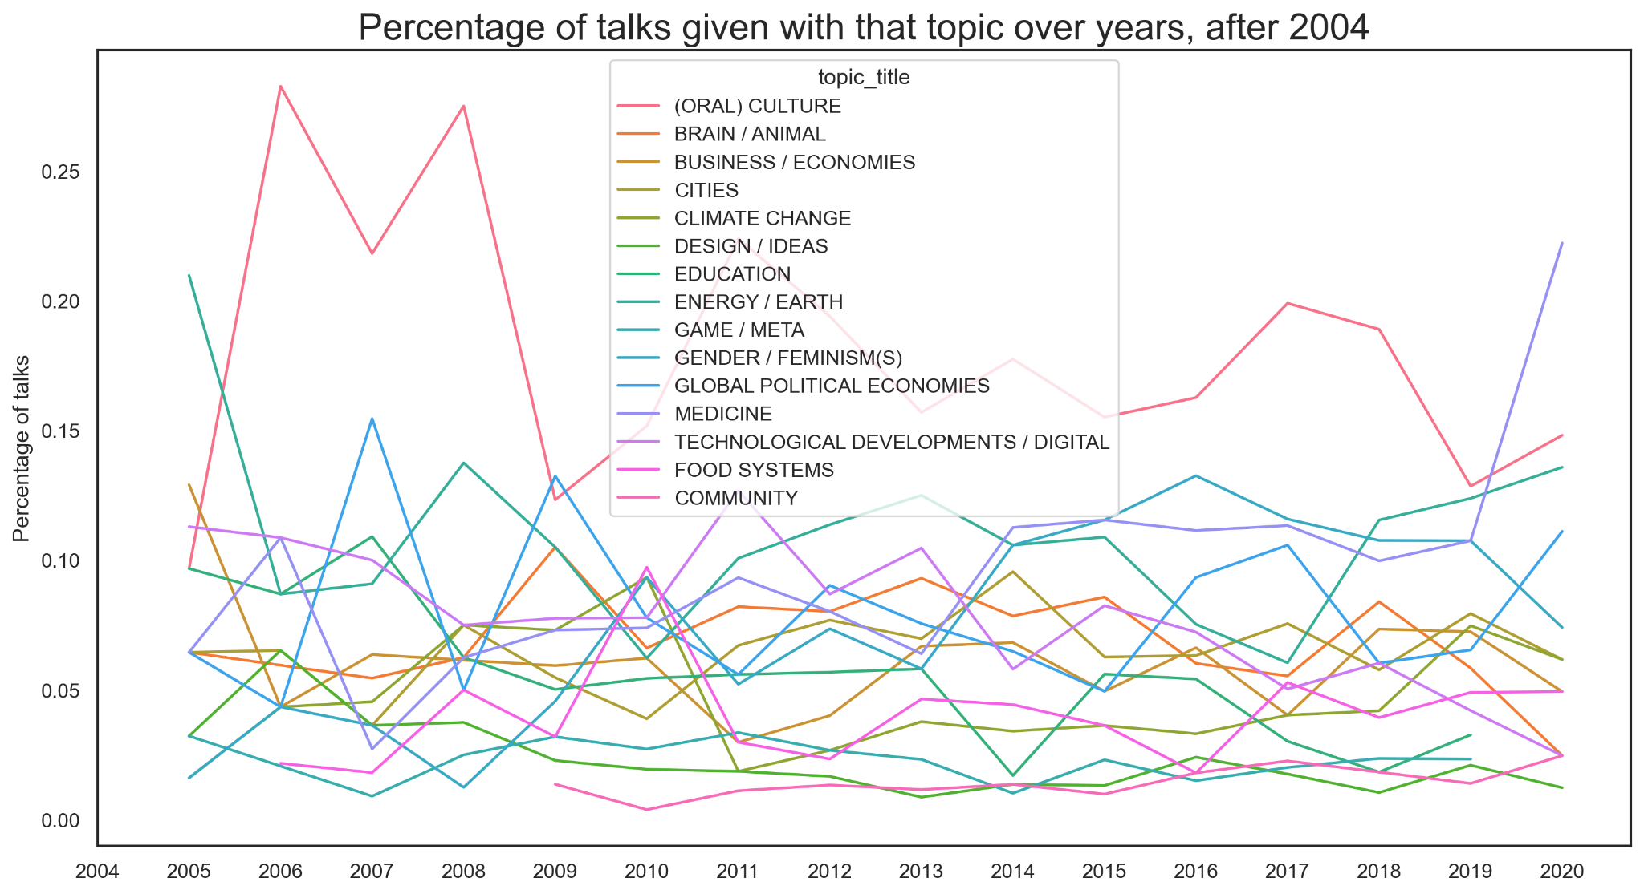
Percentage of
Talks
per topic
per year

Slide 37
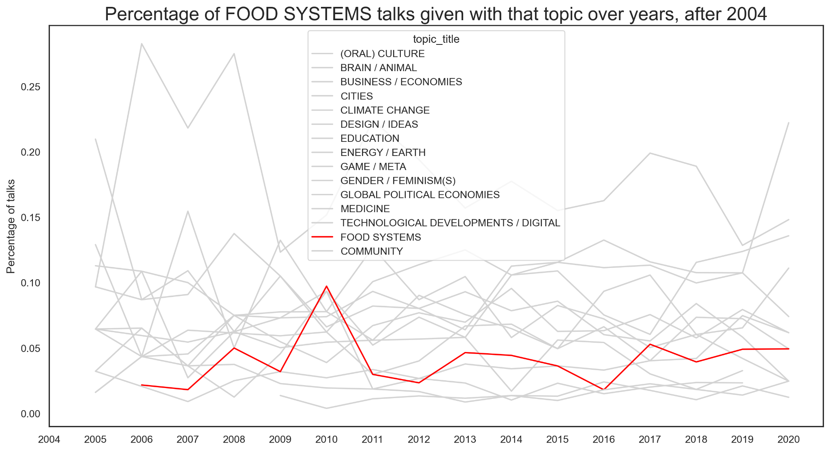
Percentage of
Talks
FOOD SYSTEMS
per year

Slide 38
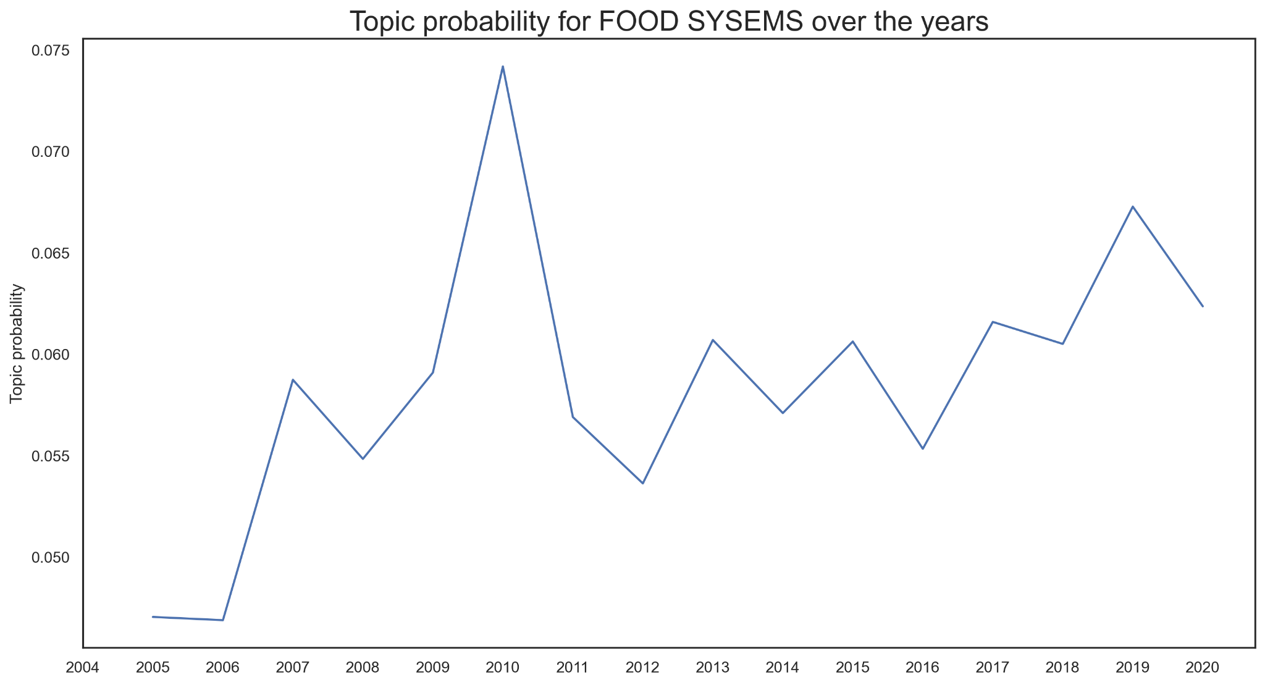
Topic
Probability
FOOD SYSTEMS
over years

Slide 39
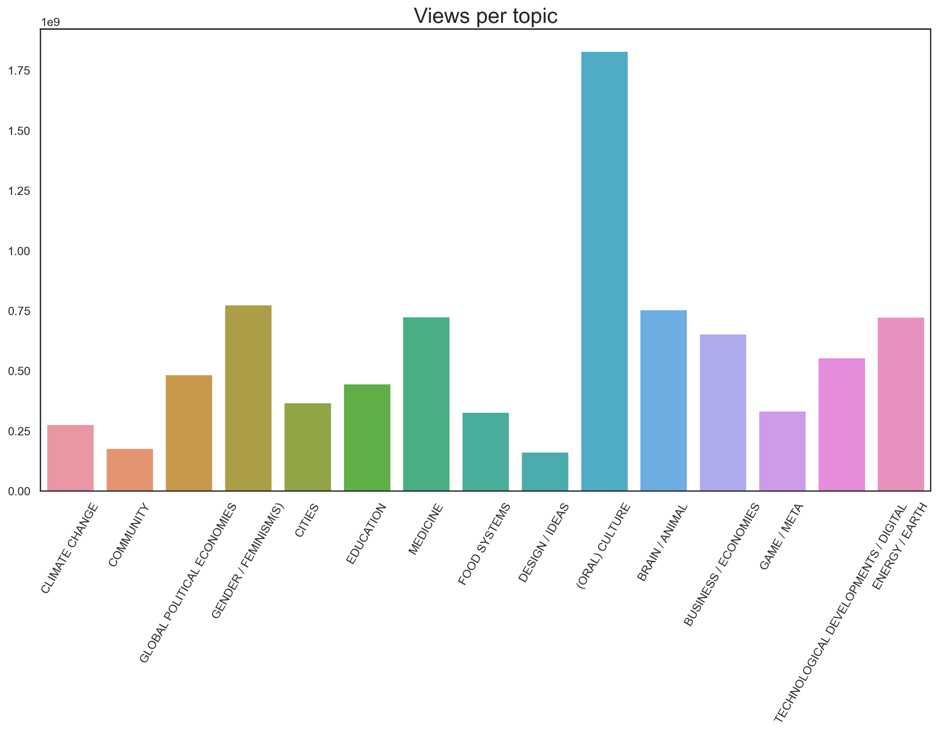
Views
per topic

Slide 40
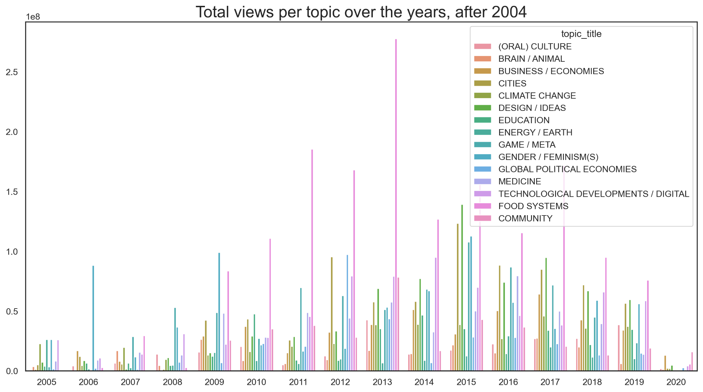
Total views
per topic
over years

Slide 41
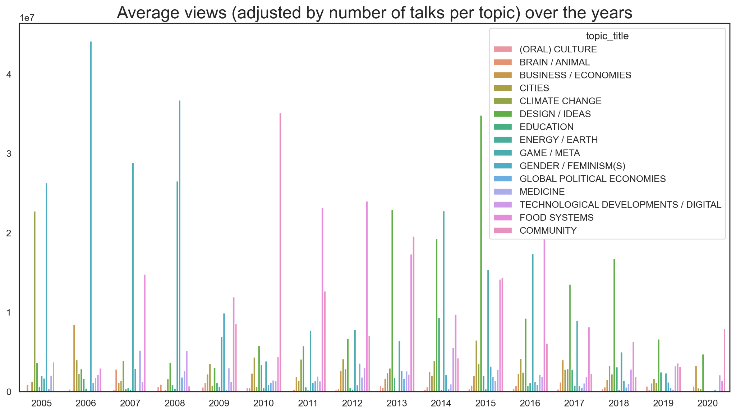
Average views
per topic
over years

Slide 42
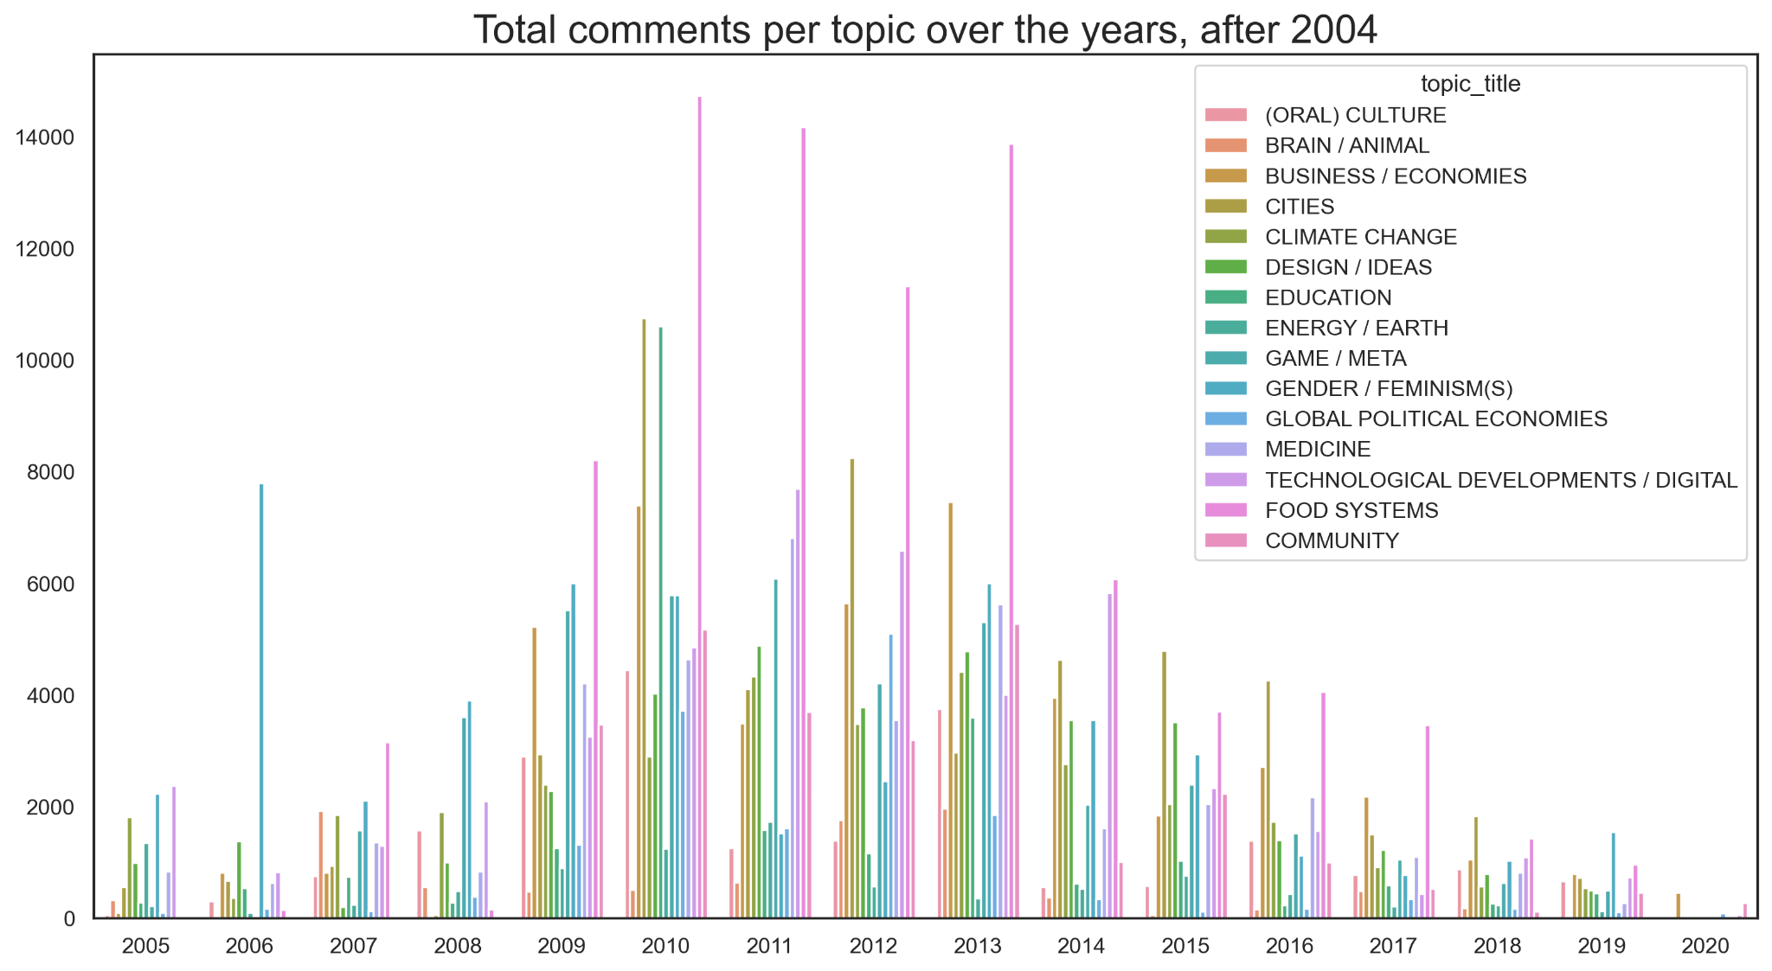
Total
comments
per topic
over years

Slide 43
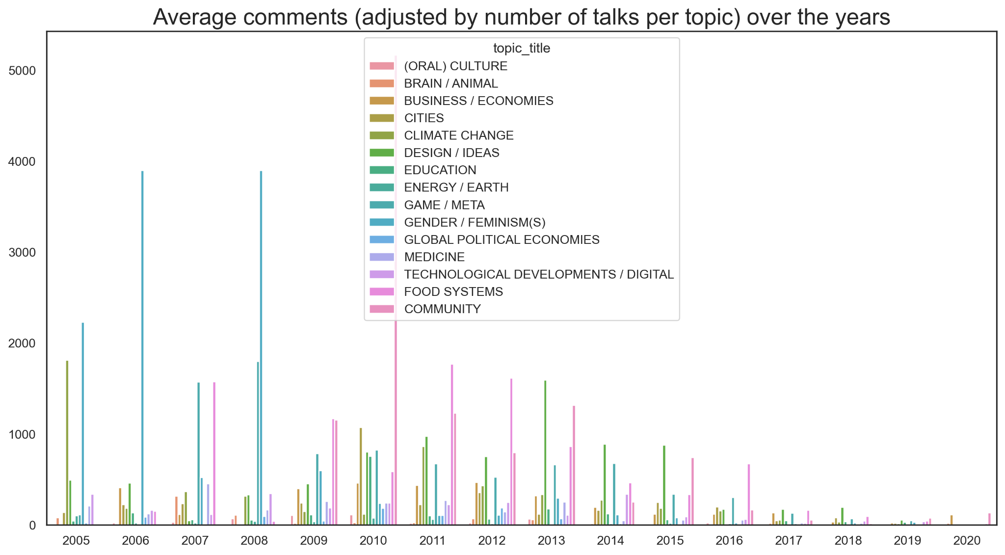
Average
comments
per topic
over years

Slide 44
FEMINISM(S)

Slide 45
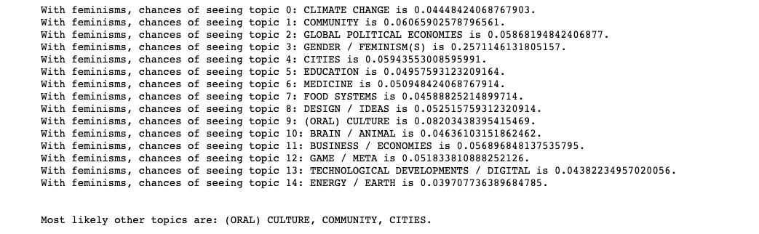
Associated
Topics

Slide 46
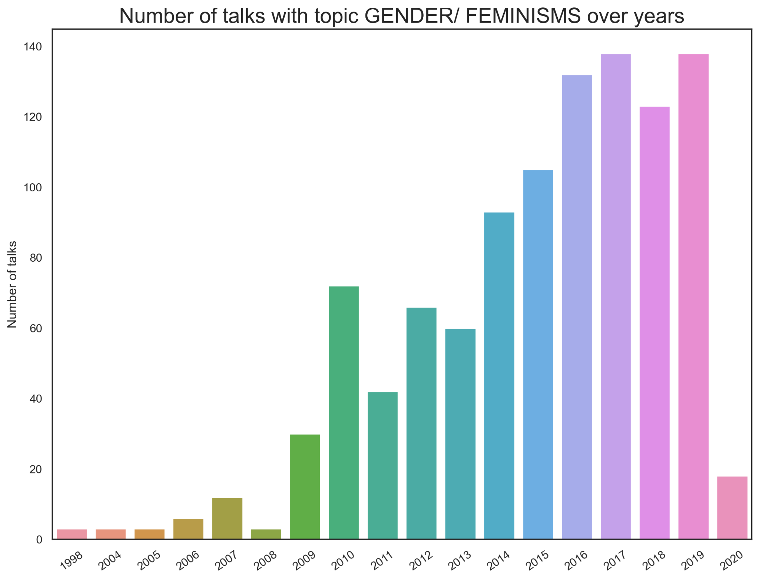
Number of
FEMINISM(S)
Talks
over years

Slide 47
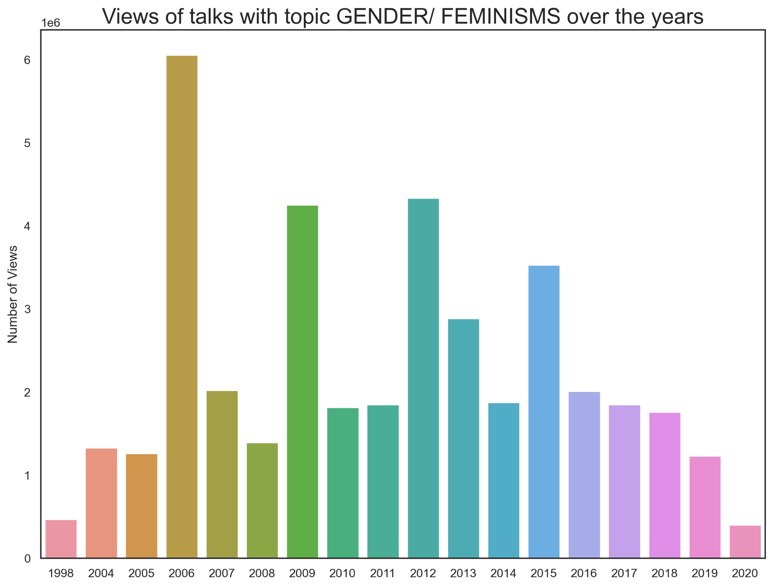
Viewership
FEMINISM(S)
over years

Slide 48
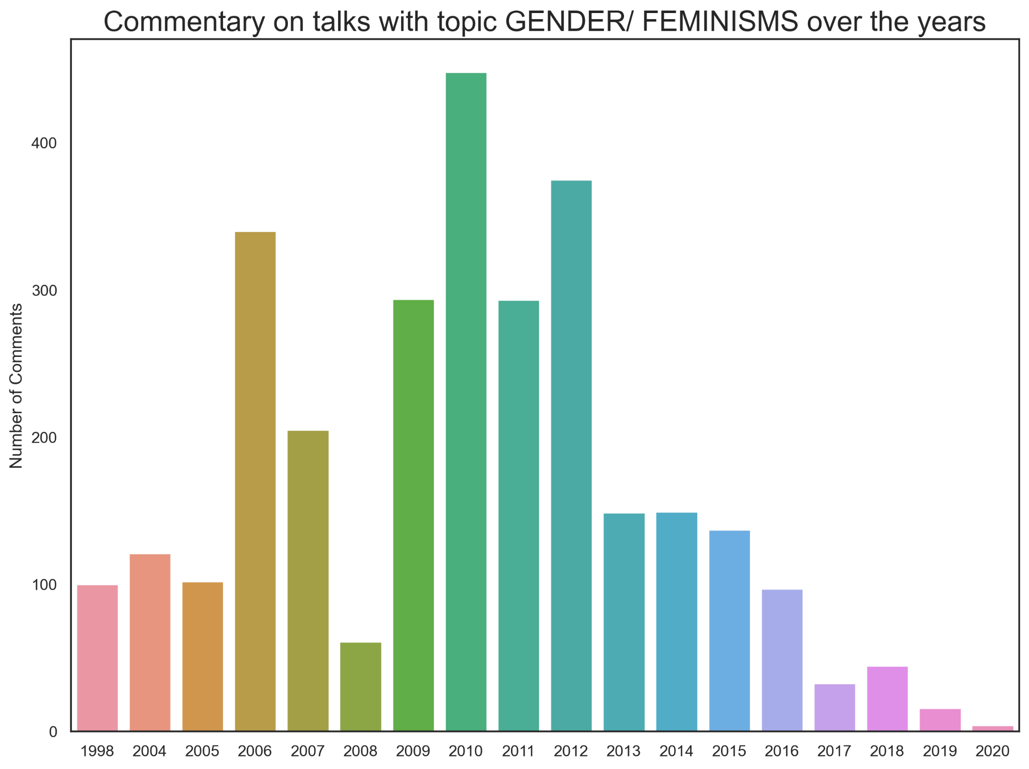
Commentary
over years
FEMINISM(S)

Slide 49
REC SYS

Slide 50
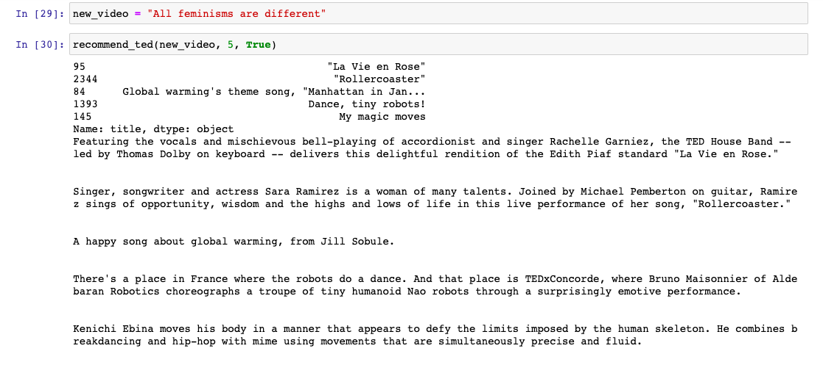
Sample
Rec

